Slide 1

CardioCare
Early Detection and Diagnosis of Heart Disease
Project Guide:
Sri. B. Ramana
Assistant Professor,
CSE Department
G Pulla Reddy Engineering College
Batch CSE – B20:
Mitta Mahesh Reddy – 219X5A05L2
Chintha Lakshmi Narayana – 219X5A05L4
Shaik Mohammad Adil – 199X1A05B9

Slide 2

Agenda
01
Abstract
02
Dataset
03
Project Flow
04
Algorithms
05
Architecture Overview
06
Working of CNN-LeNet5
07
Conclusion
08
References

Slide 3
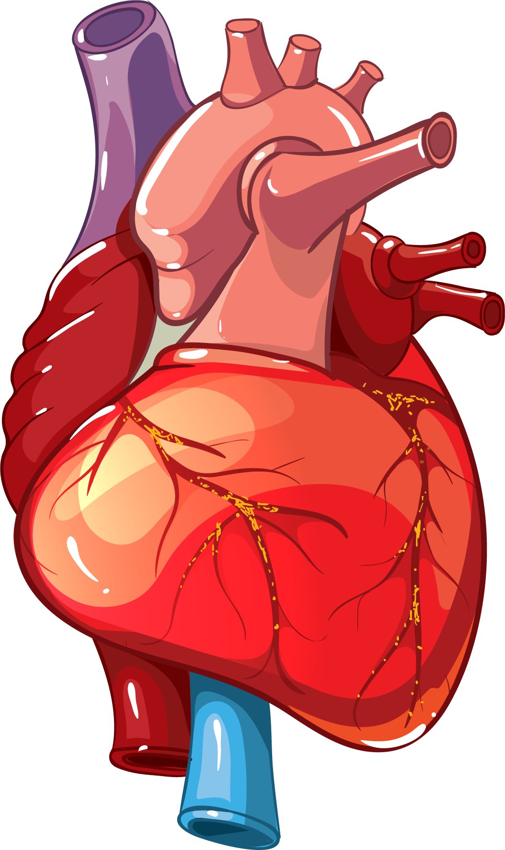
Abstract
This study explores using deep learning to detect heart disease, which is a major cause of death worldwide. we used advanced machine learning techniques to analyze various medical data, including electrocardiograms, aiming for early and accurate diagnosis. we test different deep learning models, like convolutional neural networks- LeNet5 to find the best one for heart disease detection. The study uses a diverse dataset of electrocardiograms to train the models, helping them recognize complex patterns. Results show that deep learning can significantly improve heart disease diagnosis compared to traditional methods. Early detection of heart disease is crucial for better treatment and patient outcomes, highlighting the importance of this research.

Slide 4
Dataset
The preliminary step involves gathering and preparing datasets related to heart disease detection from various sources. These datasets can be found on Kaggle, a well-known platform for datasets spanning multiple domains and applications, which serves as the foundation for our project. The reference link is as follows: https://www.kaggle.com/datasets/maheshmitta12/ecg-dataseta.
Dataset includes 5 classes:
S - Supraventricular Beats
V - Ventricular Beats
F - Fusion Beats
U - Unknown Beats
N - Normal Beats

Slide 5
Dataset
Supraventricular Beats
Ventricular Beats
Fusion Beats
Normal Beats
Unknown Beats

Slide 6






Technologies

Slide 7
Project flow
ECG Dataset
Dataset
Split Data into Training and testing
Train and Bulid Deep learning model – LeNet5
validation, Prediction
User Interface
Training Data
Testing Data
Train Model
Build Model
Input Image
Predict Result
S
V
F
U
N

Slide 8
Algorithm
Convolutional Neural Network
A convolutional neural network is a feed-forward neural network that is generally used to analyze visual images by processing data with grid-like topology. It’s also known as a ConvNet. A convolutional neural network is used to detect and classify objects in an image.
Introduction:
LeNet-5: A groundbreaking convolutional neural network (CNN) architecture developed by Yann LeCun and his team in 1998.
Revolutionized computer vision tasks and paved the way for modern CNNs.

Slide 9
Architecture Overview
Convolutional Layers:
Consists of two convolutional layers followed by max-pooling layers.
LeNet-5 introduced the concept of using convolutional layers for feature extraction.
Fully Connected Layers:
Contains three fully connected layers at the end of the network.
Utilized for classification tasks.

Slide 10
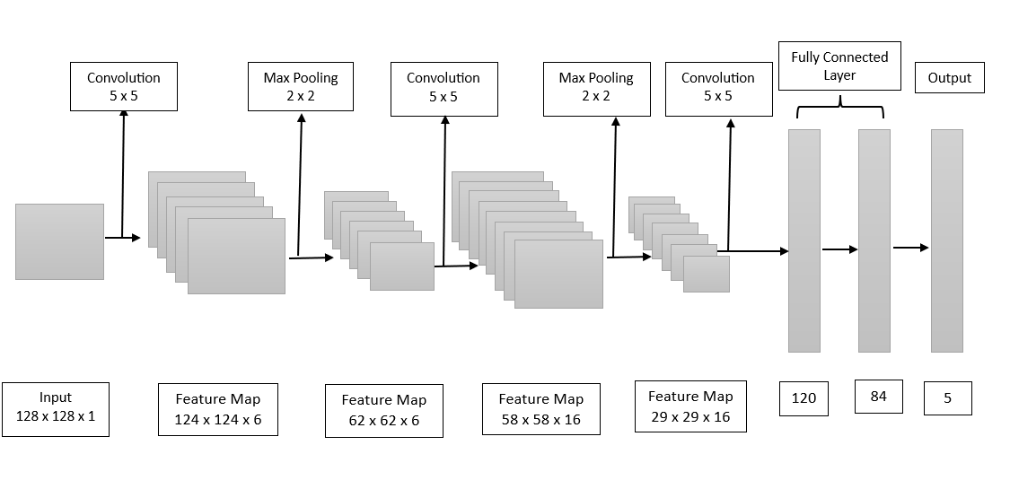
Working of CNN-LeNet 5

Slide 11
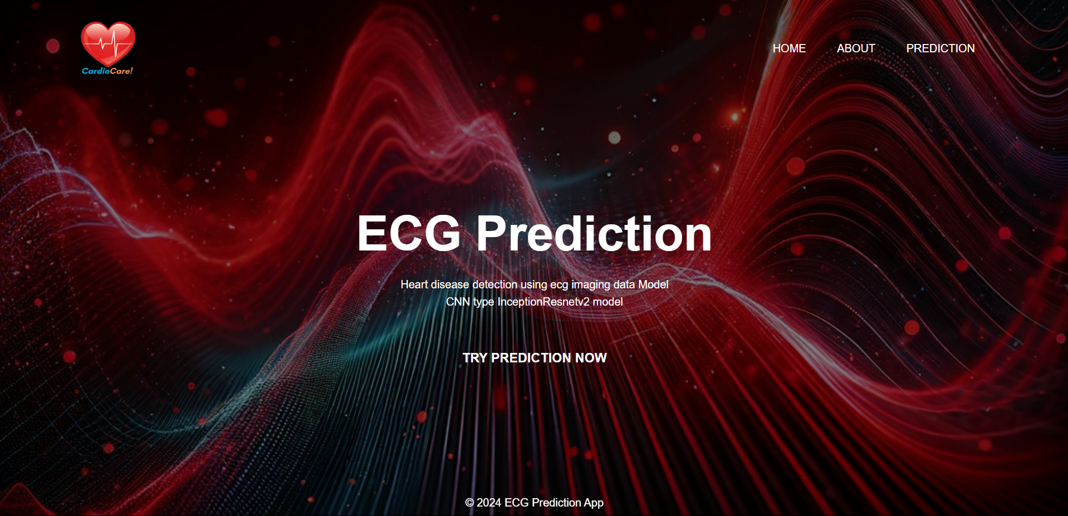
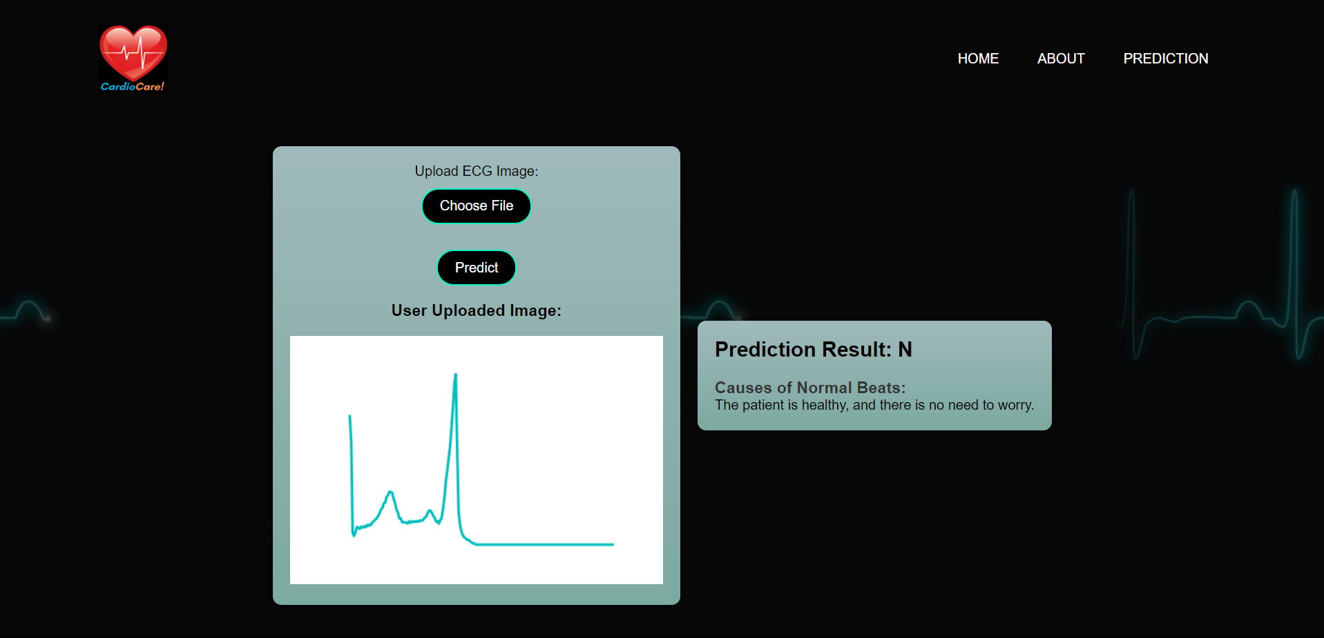
Landing Page
Prediction Page

Slide 12
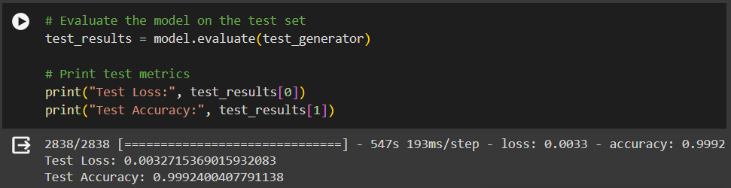
Results
Test Accuracy: 99%

Slide 13
Conclusion
In conclusion, the utilization of deep learning, particularly convolutional neural networks (CNNs), presents a transformative approach to early detection and diagnosis of heart disease, exhibiting superior performance compared to traditional methods.
This innovative paradigm not only enables individualized risk assessments and timely interventions but also promises to alleviate the burden on healthcare systems, ultimately leading to improved patient outcomes and enhanced healthcare efficacy.

Slide 14
References
Prabhu, Ramaprabha; et al: Study of ECG Analysis based Cardiac Disease Prediction using Deep Learning Techniques
Awais, Zahid; et al: Prediction of Heart Disease Using Deep Convolutional Neural Networks.
Shaimaa Mahmoud, Mohamed Gaber, Gamal Farouk, Arabi Keshk, "Heart Disease Prediction Using Modified Version of LeNet-5 Model", International Journal of Intelligent Systems and Applications(IJISA), Vol.14, No.6, pp.1-12, 2022. DOI:10.5815/ijisa.2022.06.01

Slide 15
Thank you

